Slide 1
Data Security and Protection Toolkit
Welcome
The session will commence at 12.30
Please mute your microphone
Presented by: David Ingham
and John Hodson, NHS Digital

Slide 2
What we are doing currently
Prototype system made available to over 250 volunteers.
Ongoing development.
1:1 testing and user research ongoing.
Developing content and guidance.
Working with key bodies (ICO, NCSC, CQC, NHS England etc.).

Slide 3
Update
The requirements of the Data Security and Protection Toolkit (DSPT) are designed to encompass the National Data Guardian review’s 10 data security standards.
The requirements of the DSPT support key requirements under the General Data Protection Regulation (GDPR), identified in the NHS GDPR checklist.
The IG Toolkit assessed performance against three levels 1, 2 and 3. Organisations were required to provide evidence of compliance with (at least) level 2 for all elements of their assessment. The DSPT does not include levels and instead requires compliance with assertions and (mandatory) evidence items.
The assertions and evidence items are designed to be concise and unambiguous. Documentary evidence is only requested where this adds value.
Some evidence items will not be required where an organisation uses NHSmail, or has in place an existing relevant standard (Cyber Essentials PLUS, ISO 27001, Public Service Network Information Assurance).

Slide 4
New requirements in DSPT
Leaders and board members receive suitable data security and protection training.
Organisations undertake process reviews to identify and improve processes which have caused breaches or near misses.
Organisations must act on CareCERT alerts and notifications.
Organisations must complete a specific business continuity test for data security.
Organisations must survey their software for unsupported systems.
Organisations must ensure all networking components have had their default passwords changed.
Large organisations must ensure their web applications are secure against top 10 vulnerabilities.
Large organisations must undertake a penetration test annually.
Large organisations must flag any suppliers with significant issues complying with the NDG standards to NHS Digital.

Slide 5
FAQs
SIRI tool being updated to GDPR breach reporting tool and NIS directive for applicable organisations ready for May 2018.
Current Toolkit will stay in read-only format.
October baseline submission for large organisations.
Publication will be at summary level not detailed.
Training requirement largely unchanged.
Ability to chose “Secondary sectors” to be developed

Slide 6
Getting started…
Transition will begin late February 2018 (prioritise sites who have completed 14.1).
Initially, registration will be by invitation.
The first registered user for your organisation will set up any subsequent users.

Slide 7
Care Quality Commission (CQC)
CQC well led inspections will include data security, we are testing approaches currently.
The focus so far has been on how boards gain data security assurance
Data security is wider than cyber.
Use information from DSPT and wider intelligence to set the prompts for the inspection.

Slide 8
Communications
Webinars (both general and sector specific).
Getting started guide.
Presentation for IG leads to use on what’s changing (need some volunteers).
Interested to know, what additional communications would you find useful?

Slide 9
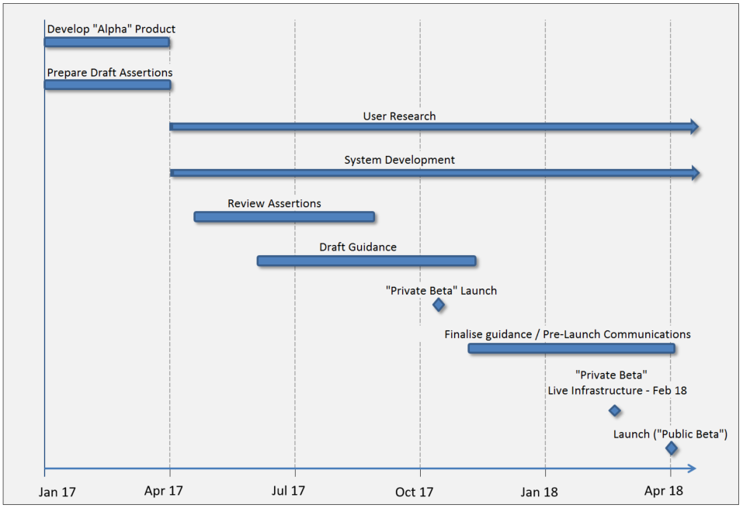
Data Security and Protection Toolkit Plan

Slide 10
Demonstration

Slide 11
Questions?
cybersecurity@nhs.net

